Slide 1
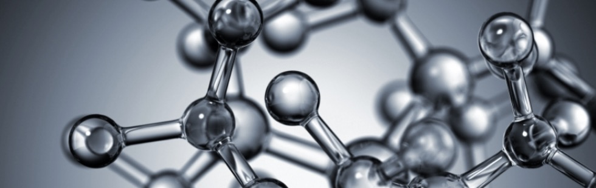
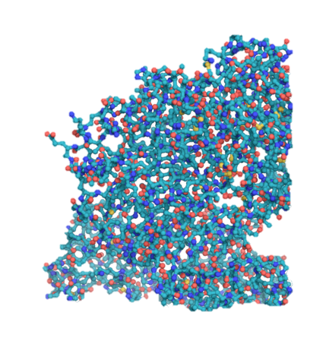

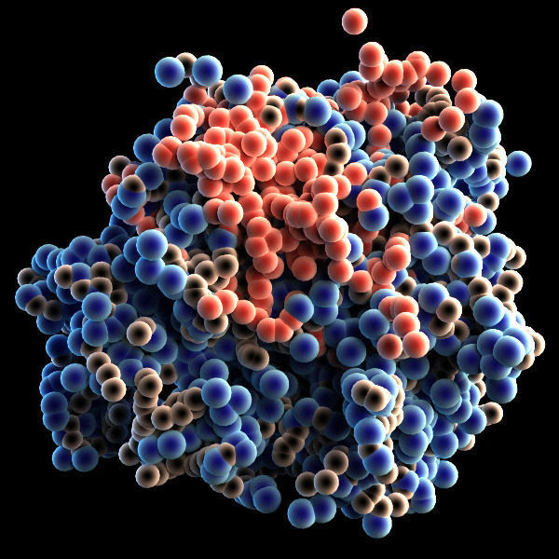
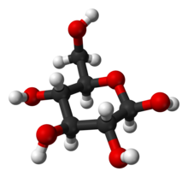
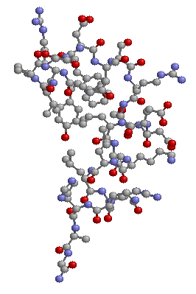


Artificial Chemistries
Basic examples
Daniel Rodríguez Cárdenas
Carlos Andrés Sierra
Alife research group,
Universidad Nacional,
Bogotá, Colombia.
Notes:
© Copyright Showeet.com – Free PowerPoint Templates

Slide 2
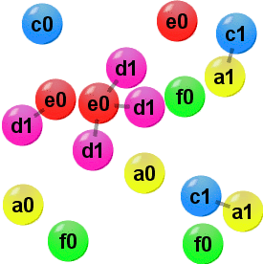
Basic definition
An artificial chemistry (a.c.) is a tool. It is a type of computer model that can be used to simulate different types of systems.
The type of systems that has been modelled with a.c. range from chemistry, biochemistry [McCaskill, 1998], ecology, sociology, linguistic [Dittrich, Ziegler, Banzhaf, 2002]. Also a.c. has been used for practical purposes for example to model a robot brain [Ziegler & Banzhaf, 2001].

Slide 3
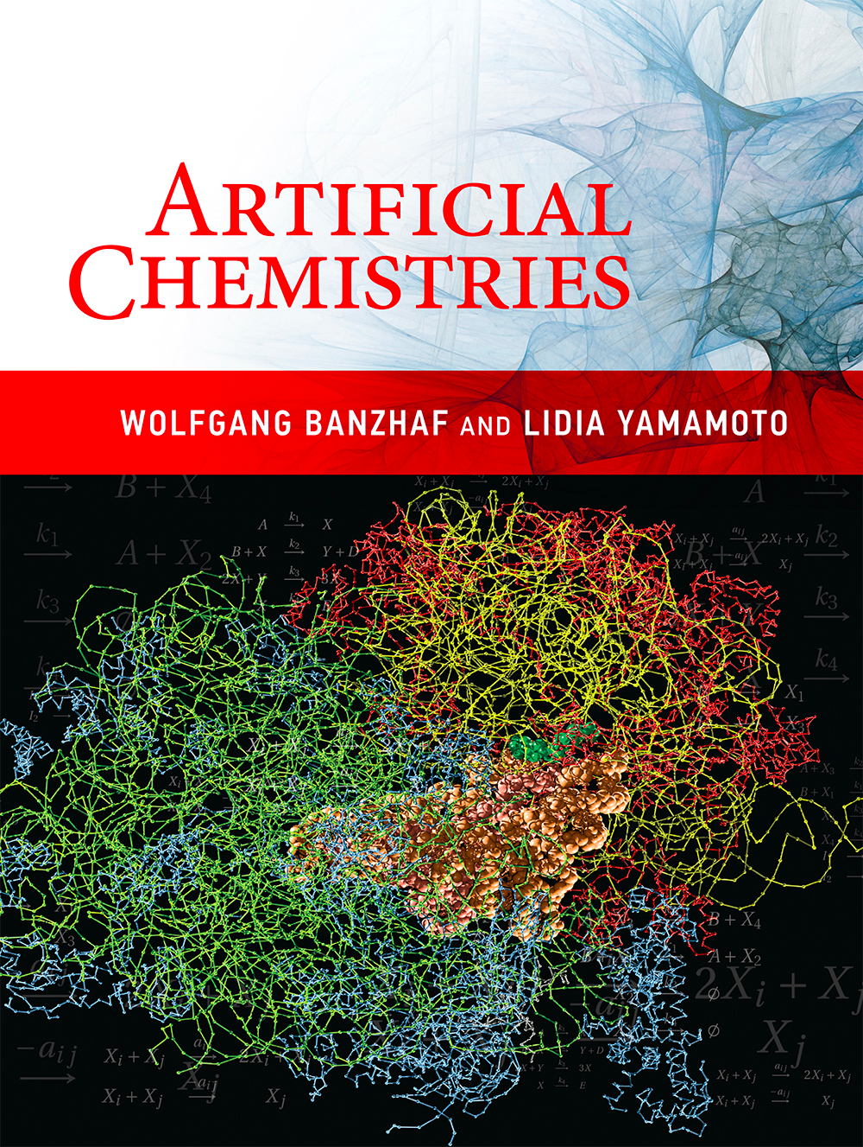
“
The field of Artificial Life is now firmly established in the scientific world. One of the original goals of the Alife field, the understanding of emergence of life on Earth.
Banzhaf Wolfgang

Slide 4
Advantages
The strength of Artificial Chemistries draws from the fact that they offer tools for an examination of both quantitative and qualitative phenomena.

Slide 5
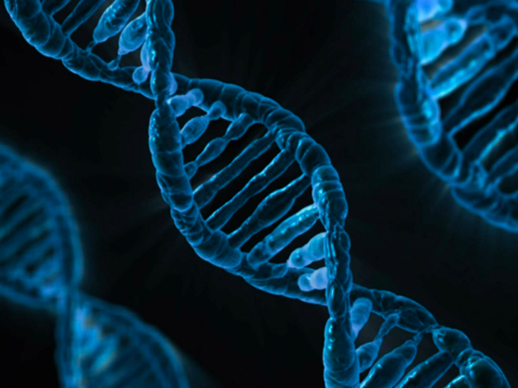
Basic Concepts of Artificial Chemistries (ACs)
ACs originated from the efforts to understand the origins of life.
Reactions: happen when a set of molecules come into contact. Some atoms are broken and other are formed.
Is a tool: to study the dynamics of system of interacting objects in a combinatorial spaces.
The strength: examination of both quantitative and qualitative phenomena.

Slide 6


Slide 7
| Motivation

Slide 8
Artificial life and artificial chemistry
Artificial Life
Artificial Chemistry
Abstracts from specific examples of real living process and tries to integrate different approaches into one interdisciplinary attempt to extract the firs principles of life.
By abstracting from natural molecular processes, tries to investigate the dynamics of these complex systems.

Slide 9
Motivation & Goal
Simulate (bio-)chemical processes, e.g. origin of life from primordial soup of molecules.
Explore alternative computation models: chemical computing.
Understand emerging/self-maintaining structures, e.g. chemical organization theory .

Slide 10
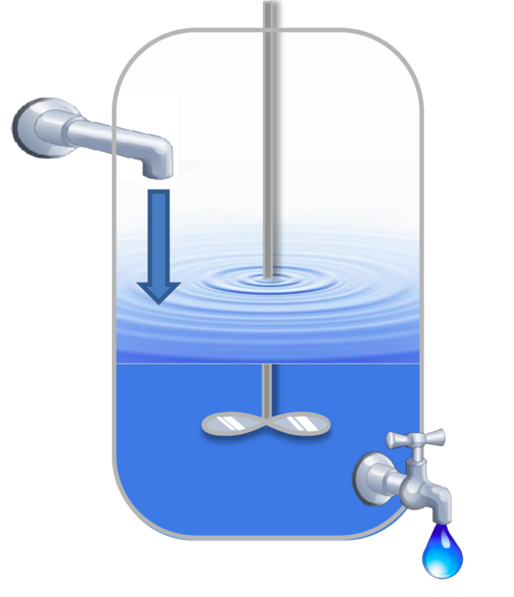
Terminology
Molecular species.
Multiset.
(Well-stirred) Vessel.
Concentration.
Chemical reaction.
Auto-catalytic sets

Slide 11
Basic concepts
Artificial chemistry
Man made system that is similar to real chemical system.
Defined by a trype (S,R,A)
Set of molecules S.
Set of rules R.
Reactor algorithm A – Dynamics.
S: all valid molecules that may appear in an AC.
R: interactions between molecules in S.
A: determines how R is applied to a collection of molecules.

Slide 12
The notion (1)
“ Instead of mathematical operations being executed on symbols without connection to a material world, in an artificial chemistry, operations include a notion of material”
A symbolic equation: 5+6 = 11
5
6
11
A quasi-chemical reaction: 5+6 -> 11

Slide 13
The notion (2)
The first complication:
Reactions are symmetrical
A symbolic equation: 5/6 = NOT Possible
6
5
1
A quasi-chemical reaction: 6/5 -> 1
Since 1.2 is closer to 1
We need an algorithm!!

Slide 14
The set of molecules S- Objects
The set of molcules S = { S₁, …, S_{i} ,… S_{n} }, describes all different valid molecules that might appear in the Artificial Chemistry.
A molecules’ representation is often referred to as its structure and kept apart from its function, which is given by the reaction rules R.
The description of the valid molecules and their structure is usually the first step in the definition of an artificial chemistry.
This is analogous to the part of chemistry that describes what kind of atomic configurations form stable molecules and how these molecules appear.

Slide 15
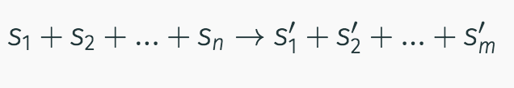
The set of Rules R - Interactions
The set of reaction rules R describes the interactions between molecules.
A rule can be written acording to the chemical notation of reaction rules in the form:
A reaction rule determines the n components on the left hand side that can react and subsequently be replaced by the m components on the right hand side.
A rule is applicable only if certain conditions are fulfilled. The major conditions is that all components written on the left hand side of the rule are avaliable.

Slide 16
Reactor Algorithm A - Dynamics
The reactor algorithm A is in charge of simulating the dynamics of a reaction vessel.
It determines how the set R of rules is applied to a collection of molecules P, called reactor, soup, reaction vessel or population.
S is a being set, P is correctly termed a multiset. The index of S indicates a type of molecule. P indicates a place in the population which could be occupied by any type of molecule.
S
P
c
c
c
a
b
b
a
b
c

Slide 17
More definitions
P
The cardinality of P is the total number of elements:
Card(P) = 6.
The multiplicity of an element is the number of times it appears in the multset.
a = 1
b = 2
c = 3
c
c
b
a
b
c

Slide 18
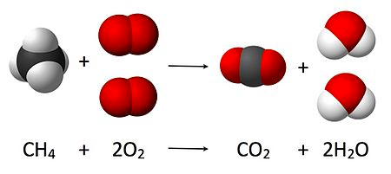
Artificial Chemistries, an snapshoot?
It is not so interesting to see only a snapshot of a chemistry, but rather its changes over the time!

Slide 19
Algortihm A
Algorithm A is conceptually independent of the representation of R and P, its performance and algorithmic complexity will often influenced by R and P represented as data structures in the computer.

Slide 20
Stochastic molecular collisions (1)
A typical algorithm draws a random sample of molecules from the population P, assumes a collision of these molecules and checks whether any rule R can be applied.
If the conditions of a rule r are fulfilled, the molecules are replaced by the molecules on the right-hand side of r.
Notes:
Parámetros constantes tales como la energía, información espacial o la temperatura pueden ser introducidas a la regla para volverla más realista.

Slide 21
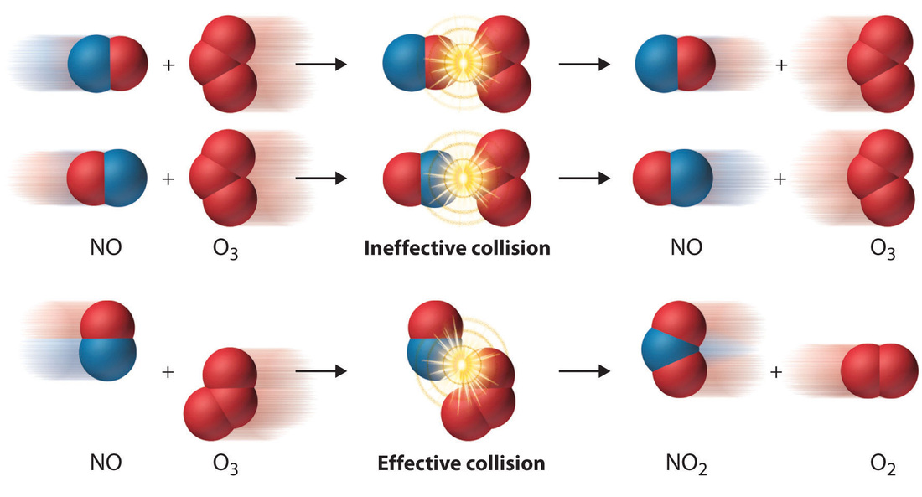
Stochastic molecular collisions (2)

Slide 22
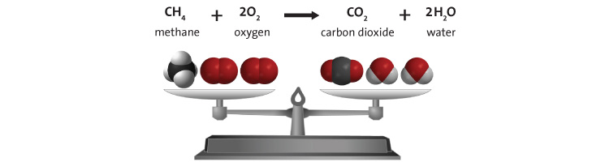
Stochatic simulation of chemical reactions
Check at the same time all the collisions is not efficient. Some algorithms have been proposed to avoid the computation expending.
Gillespiel’s simulation, at every iteration, decides which reaction will occur and when. Therefore, only effective collisions are computed, which can save substantially on simulation time.

Slide 23
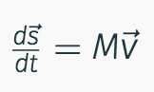
Continuos differential or discrete difference equations
The use of numerical approximation to describe the reactions over the time is a further step.
Here we can use a a big number of molecules, however one of the disadvantages of this approach is that concentrations could be o small that can not be represented by floating point numbers.

Slide 24
Metadynamics
It improves the equation model approach because it assumes that the number of species and therefore the number of equations may change over the time.
Differential equation system is changed by adding and/or removing equations
It combines the speed of a differential equation with the physical accuracy of a stochastic molecular collision simulation.

Slide 25
Comparison of reactor algorithms
Entities | Formalism | Interaction
Individual molecules | Stochastic molecular collisions | Collision and rule-based reactions
Molecular species | Stochastic simulation of chemical reactions | Possible reaction channels
Molecular species | Concentration/rate differential equations | Coupling between equations
Dominant molecular species and background | Meta-dynamics | Coupling between equations and random changes
Dominant molecular species and single molecules | Explicit simulation of molecules and ODE of dominant species | Coupling between equations and collision-based reactions of small number of molecules

Slide 26
Measuring time

Slide 27
Pattern Matching

Slide 28
Spatial Topology

Slide 29
Limited Resources

Slide 30
Summary

Slide 31
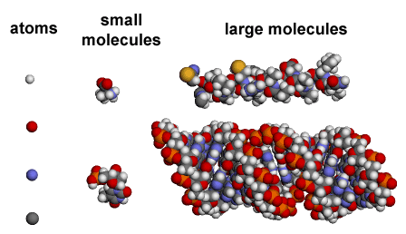

Slide 32
What do we mean by innovation?
Innovation is a process that implies:
Transformation
Change
Renovation
Of components and relationships.
dynamic and emergent
that impacts the system and its environment
Notes:
© Copyright Showeet.com – Free PowerPoint Templates

Slide 33
“
The history of life
is a history of innovations
Andreas Wagner
Wagner, A. (2011). The Origins of Evolutionary Innovations: A Theory of Transformative Change in Living Systems. Oxford: Oxford University Press

Slide 34

Which of the objects are stable?

Slide 35
The logic of bio-inspired computing and engineering
Methods developed in biologically-inspired fields are distinctive in that they focus on populations of agents that interact with each other and with the environment, generating bottom-up behavioral functional or structural patterns that can be interpreted as innovations.
Size scale

Slide 36
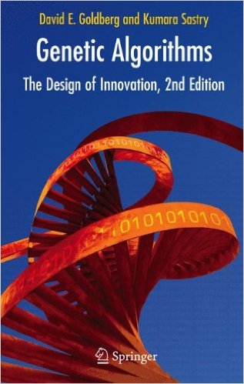
Evolutionary innovation
Evolutionary computation connects the two basic process of innovation: continual improvement and discontinuous change.
continual improvement
Selection + mutation =
Selection + recombination =
disruptive innovation

Slide 37
Three trends for potential applications
Mechanisms
for the constant generation of novelty (variation, innovation and emergence)
Simulated scenarios
Computational processes
(artificial societies or markets) in which the impact of specific innovations can be tested
in which the space of possibilities for an innovation is explored

